Slide 1


SIG VAKGROEP Integration Javascript to Typescript Niels Daalhuisen Henk Jan van Wijk Jeroen Rijnboutt

Slide 2
AGENDA
Introduction into Typescript
Migrating from Javascript to Typescript
Hands-on

Slide 3

Introduction into Typescript
Origin
Microsoft
Anders Hejlsberg – Lead architect C#
Javascript lacking when working on complex code bases
Multiple tools to compensate for the extremely dynamic nature of Javascript

Slide 4
Introduction into Typescript
Why Typescript?
Strict type checking
Finding issues on compile instead of runtime
Added interfaces and types for clear structure of data
Ability to better work with the IDE
Easier to refactor
Easier to work with as a new team member (harder to screw up)
Improved static code analysis
Not much different from writing JSDoc into your Javascript code
"Astronomy vs quantum mechanics"

Slide 5
Introduction into Typescript
Do we migrate from Javascript to Typescript asap?
There are ways to make in work with Javascript
Not necessary to start today
No need to migrate everything at once
Start with code that is used and updated often: Support libraries
Improved long term stability is the goal
Earlier means less refactoring and longer benefit

Slide 6
Introduction into Typescript
What is Typescript?
Npm library
tsconfig.json
Compiler
Integrated into VS Code
Builds on the Javascript primitive types
string, boolean, number, array, undefined, null, object
Infers the type when not declared
Will not stop you from running the compiled Javascript code (into errors)

Slide 7
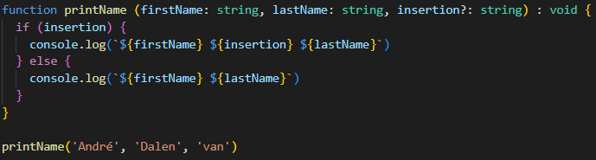
Introduction into Typescript
Simple Syntax

Slide 8
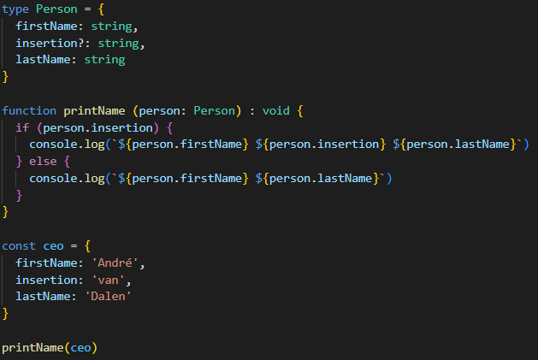
Introduction into Typescript
Simple Syntax with object type

Slide 9
Introduction into Typescript
Modules: CommonJS vs ECMAScript
require vs import
Synchronous vs Asynchronous module load
CommonJS = synchronous load on startup
ESModules = asynchronous load
Can have an impactful influence on startup/debug time
Full ESModule support since nodejs v13.2.0
Not Typescript specific

Slide 10
Javascript to Typescript
Preparation
Decide initially which type checking options you want to enable, some will have more impact in the migration than others like ‘noImplicitAny’
Which type of code style (eslint) are you using
Find the typescript variant
Make a list of the default changes you need to make to every file:
List of modules to install
List of modules to uninstall
Updates to package.json
Test framework configuration
ES Lint configuration
Decide if you want to keep using commonJS or switch to ESM (ECMAScript modules)

Slide 11


Javascript to Typescript
Check for the used modules in your Javascript project if the module is already supplied with @types or you need to import them separately :
navigate to npmjs.com and search for your used modules
Check the icon after the name of the module
Already included:
Separate type definition:

Slide 12
Javascript to Typescript - steps
Initial steps:
Install typescript and node types: npm i -D typescript @types/node@16
Initialize typescript project: npx tsc –init
Update generated tsconfig.json

Slide 13
Javascript to Typescript - steps
/* Language and Environment */
"target": "es2021",
"lib": ["ES2021"],
..
/* Modules */
"module": "commonjs", /* commonjs or nodenext (ESM) */
"rootDir": "./", /* Specify the root folder within your source files. */
"moduleResolution": "node", /* node (commons) or nodenext (ESM) */
…
/* Emit */
// "declaration": true, /* Generate .d.ts files from TypeScript and JavaScript files in your project. */
// "sourceMap": true, /* Create source map files for emitted JavaScript files. */
"outDir": "dist", /* Specify an output folder for all emitted files. */
…
/* Interop Constraints */
"esModuleInterop": true, /* Emit additional JavaScript to ease support for importing CommonJS modules. This enables 'allowSyntheticDefaultImports' for type compatibility. */
"forceConsistentCasingInFileNames": true, /* Ensure that casing is correct in imports. */
/* Type Checking */
"strict": true, /* Enable all strict type-checking options. */
"noImplicitAny": true, /* Enable error reporting for expressions and declarations with an implied 'any' type. */
"strictNullChecks": true, /* When type checking, take into account 'null' and 'undefined'. */
"noUnusedLocals": true, /* Enable error reporting when local variables aren't read. */
"noUnusedParameters": true, /* Raise an error when a function parameter isn't read. */
…
/* Completeness */
"skipDefaultLibCheck": true, /* Skip type checking .d.ts files that are included with TypeScript. */
"skipLibCheck": true /* Skip type checking all .d.ts files. */
tsconfig.json

Slide 14
Javascript to Typescript - steps
Initial steps:
For eslint: npm i -D eslint @typescript-eslint/eslint-plugin @typescript-eslint/parser
When using standard coding style: npm i -D eslint-config-standard-with-typescript
Update .eslintrc file:
{
"extends": ["eslint:recommended", "plugin:@typescript-eslint/recommended"],
"env": {
"node": true,
"jest": true
},
"rules": {
"indent": ["error", 2]
}
}

Slide 15
Javascript to Typescript - steps
Update file extension from .js to .ts for all source files
Start updating files:
Convert const x = require(‘…’) to import statements: import x from ‘…’ for local imports or modules with type definitions
module.exports = {} → export each function separately
Add types to all functions
If JSDoc is available, you already have (most of) the type definitions
Functions with using object deconstruction for parameters:
Add a type for the param object (which does not need to be exported)
Typing try catch: try {…} catch (error: any) {…} or use type guards and set the type of error to unknown

Slide 16
Javascript to Typescript - Example
/**
* Retrieve device using the primary key and return the manufacturerDeviceId from that device.
* @param {object} params
* @param {string} params.deviceId - the primary key of the device
* @param {import("./utils").ApplicationConfiguration} params.pgconfig - The function configuration settings
* @param {object} params.logcontext - reference to context.log for logging
* @returns {Promise<string>} - manufacturerDeviceId
*/
async function getDeviceByPrimaryKey ({ deviceId, pgconfig, logcontext }) {
…
import { Logger } from '@azure/functions'
import { ApplicationConfiguration } from './utils'
type GetDeviceByPrimaryKeyParams = {
/** the primary key of the device */
deviceId: string,
/** The function configuration settings */
pgconfig: ApplicationConfiguration,
/** reference to context.log for logging */
logcontext: Logger
}
/**
* Retrieve device using the primary key and return the manufacturerDeviceId from that device.
*/
export async function getDeviceByPrimaryKey({ deviceId, pgconfig, logcontext }:
GetDeviceByPrimaryKeyParams): Promise<string> {
interface GetDeviceByPrimaryKeyParams {
/** the primary key of the device */
deviceId: string,
/** The function configuration settings */
pgconfig: ApplicationConfiguration,
/** reference to context.log for logging */
logcontext: Logger
}

Slide 17
Javascript to Typescript - Example
With single named argument:
/**
* Retrieve device using the primary key and return the manufacturerDeviceId from that device.
*/
export async function getDeviceByPrimaryKey(params: GetDeviceByPrimaryKeyParams): Promise<string> {
const { deviceId, pgconfig, logcontext } = params
Without object deconstruction:
/**
* Retrieve device using the primary key and return the manufacturerDeviceId from that device.
*/
export async function getDeviceByPrimaryKey(deviceId: string, pgconfig: ApplicationConfiguration, logcontext: Logger):
Promise<string> {

Slide 18
Javascript to Typescript - Unittests
For unit test files:
Install modules: npm i -D jest @types/jest ts-jest
Update jest configuration in either package.json or jest.config.js to use ts-jest as preprocessor
Also update extension from *.test.js to *.test.ts
Update the require statements to import statements
// jest.config.js
/** @type {import('ts-jest').JestConfigWithTsJest} */
module.exports = {
verbose: true,
collectCoverage: true,
reporters: [
'default’,
'jest-junit’
],
preset: 'ts-jest’,
testEnvironment: 'node'
}

Slide 19
Javascript to Typescript - Unittests
When using ‘dotenv’ to use .env files, update: require('dotenv').config() to import dotenv from 'dotenv' dotenv.config()

Slide 20

Javascript to Typescript
Q&A

Slide 21

Javascript to Typescript
Hands-on
https://github.com/AMIS-Services/sig-hands-on-js2ts

